Slide 1
Quantifying the Commons
Partner: Creative Commons

Slide 2

Me
as presenting now, Hi
Dun-Ming Huang
Shuran Yang
Data Retrieval Process for all Platforms except Flickr
Visualization on all Platforms
Modeling of License Classifier on Google webpages
Deliverable: 13 Blog posts (130~150 minutes of read), poster, video and in-person presentation
Data Retrieval Process on Flickr
Visualization on Flickr, Open Textbook Library
Modeling for License Classifier on Flickr
Deliverable: Blog post, poster

Slide 3
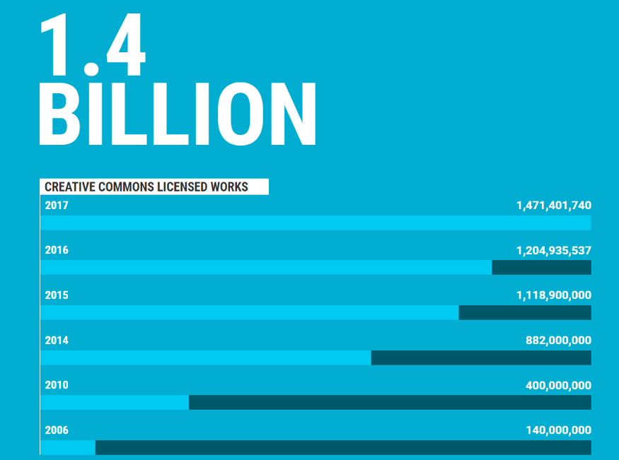
Project Objectives

Slide 4
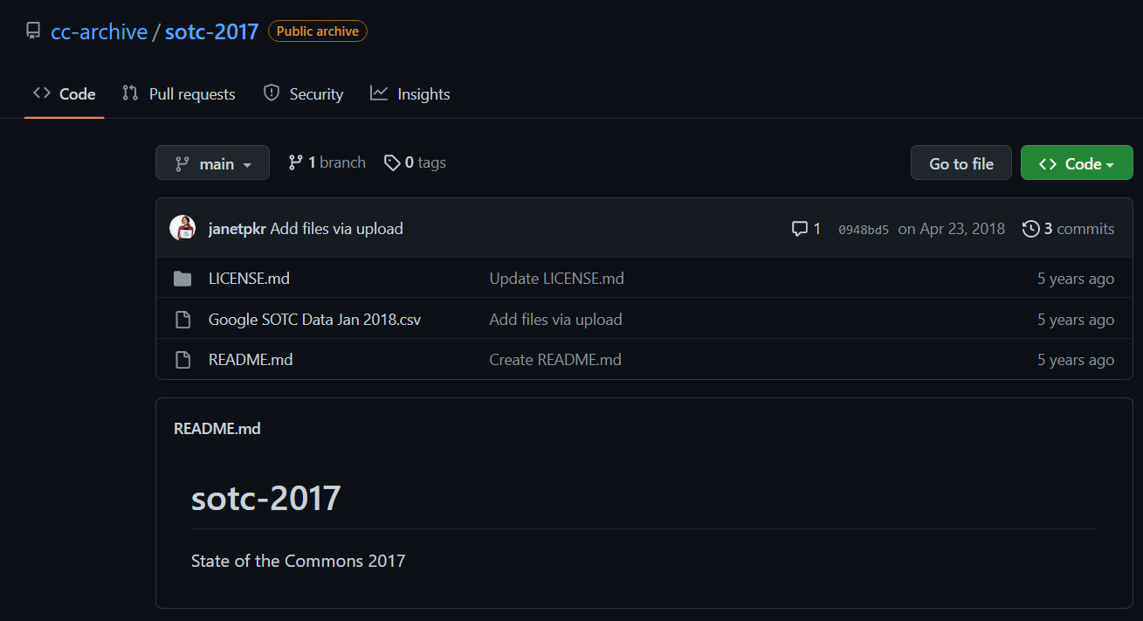
Project Objectives

Slide 5
Quantifying the Commons
Quantify the Size and Diversity of Commons

Slide 6
Project Objectives
Quantify the Size and Diversity of Commons
Retrieval

Slide 7
Retrieval: Designing Data Pipeline
Detect CC-Protected Documents/Platforms
Ask Question
Obtain Data
Obtain list of available CC tools
License-detecting API endpoint
Creative/Auxiliary subprocesses
Answer Question
Understand Data
Collect CC-Protected Documents
Modeling
Pandas-CSV pipelines
Store Tabular Data
Deliverable

Slide 8
Retrieval: Designing Data Pipeline
Ask Question
Obtain Data
Webpages
Google Custom Search API
Internetarchive
Photos
Wikicommons
Flickr
DeviantArt
Metmuseum
Answer Question
Understand Data
Videos
Modeling
YouTube
Vimeo
Deliverable

Slide 9
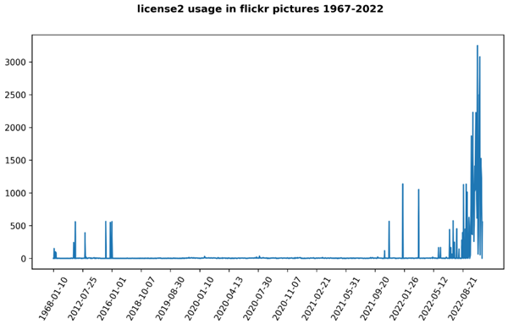
Retrieval: EDA
Google Custom Search API
Ask Question
Obtain Data
Deprecated parameters/operators
Wasted Potential
Flickr
Answer Question
Understand Data
Modeling
YouTube
Faithfulness
Wasted Potential
Deliverable

Slide 10
Retrieval: Obtain More Data
Google Custom Search API
Ask Question
Obtain Data
Geographical data
Temporal (chronological) data
Flickr
Advancements on Deduplication
Answer Question
Understand Data
YouTube
Temporal (chronological) data
Modeling
Deliverable

Slide 11
Project Objectives
Quantify the Size and Diversity of Commons
Retrieval
Visualize

Slide 12
Visualization: Engineering Datasets
Purpose of Presentation
Ask Question
Obtain Data
Exhibition
New Principles
Length vs. Area
Analyze across Axes
Stable baselines
Color for inclinations
Answer Question
Understand Data
Modeling
Deliverable

Slide 13
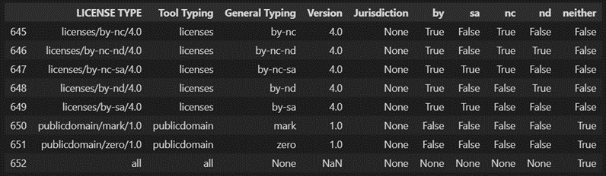
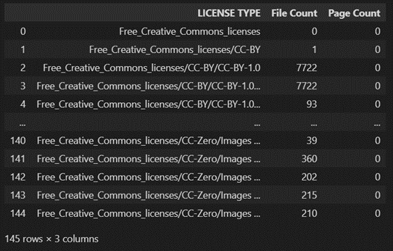
Visualization: Engineering Datasets
Ask Question
Obtain Data
Answer Question
Understand Data
Modeling
Deliverable

Slide 14
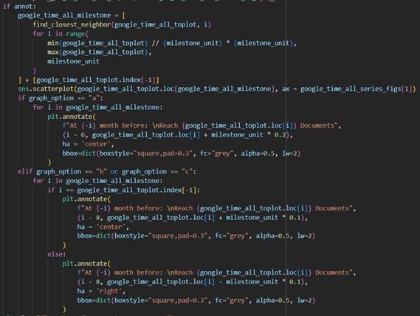
Visualization: Engineering Datasets
Ask Question
Obtain Data
Answer Question
Understand Data
Modeling
Deliverable

Slide 15
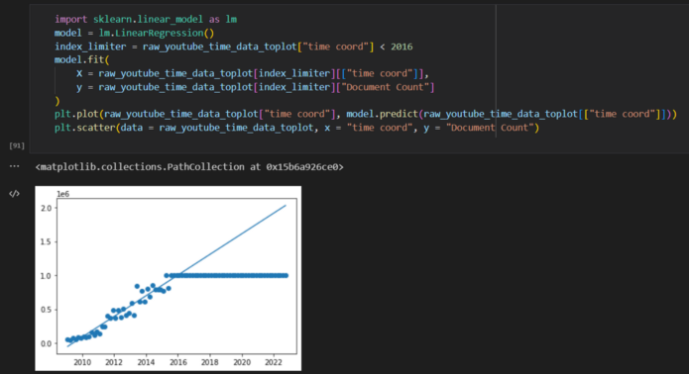
Visualization: Engineering Datasets
Ask Question
Obtain Data
Answer Question
Understand Data
Modeling
Deliverable

Slide 16
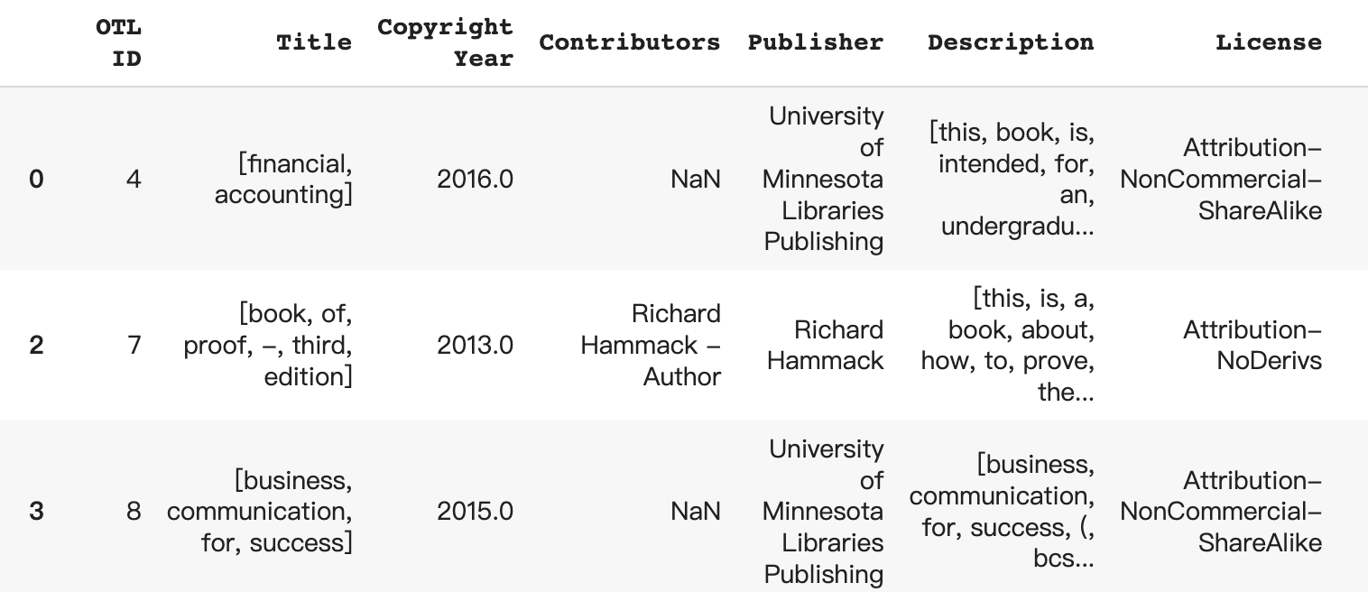
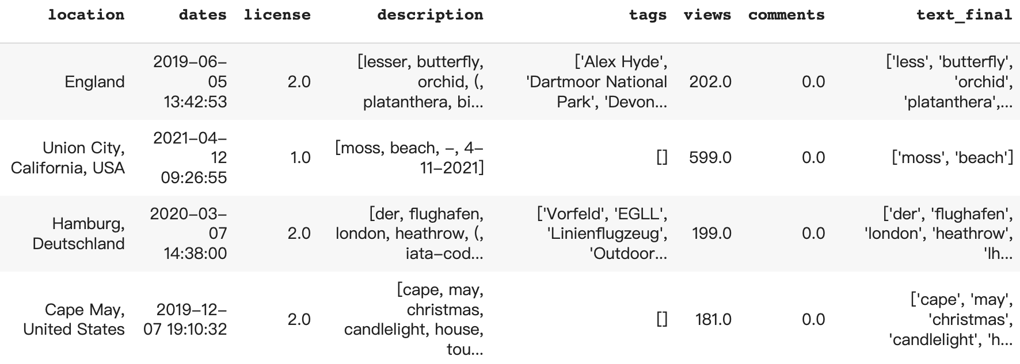
Visualization: Flickr and OTL Datasets
Ask Question
Obtain Data
Answer Question
Understand Data
Modeling
Deliverable

Slide 17
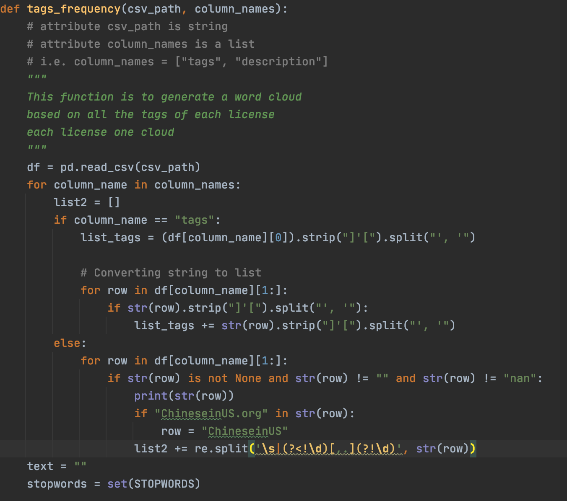
Visualization: Flickr
Ask Question
Obtain Data
Answer Question
Understand Data
Modeling
Deliverable

Slide 18
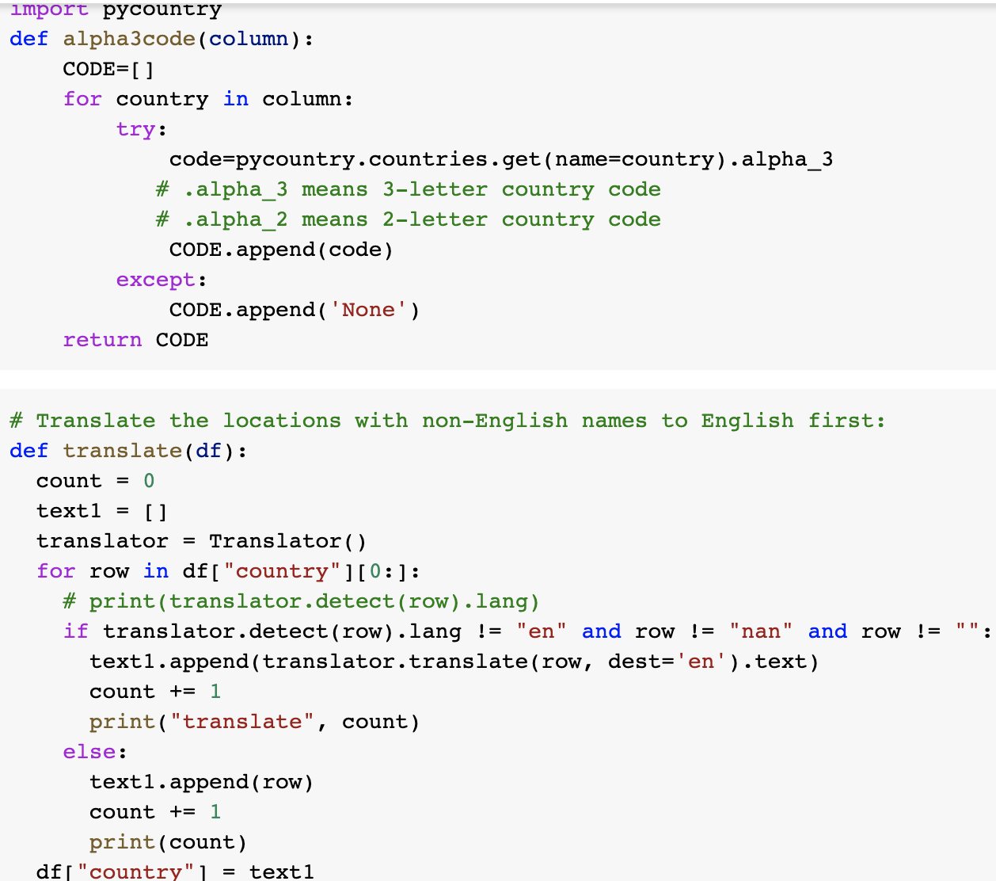
Visualization: Flickr
Ask Question
Obtain Data
Answer Question
Understand Data
Modeling
Deliverable

Slide 19
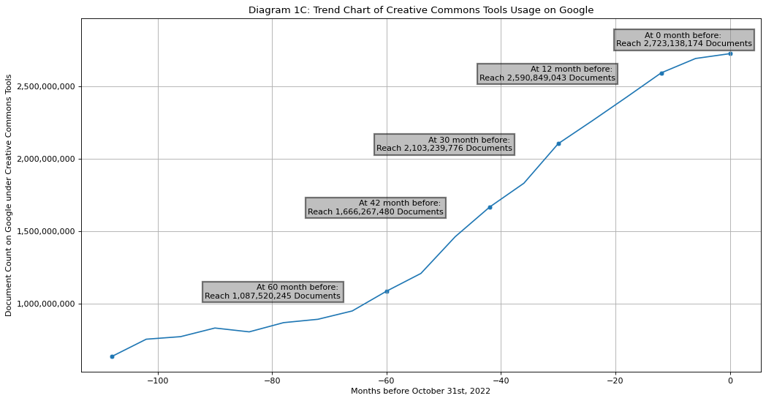

Slide 20
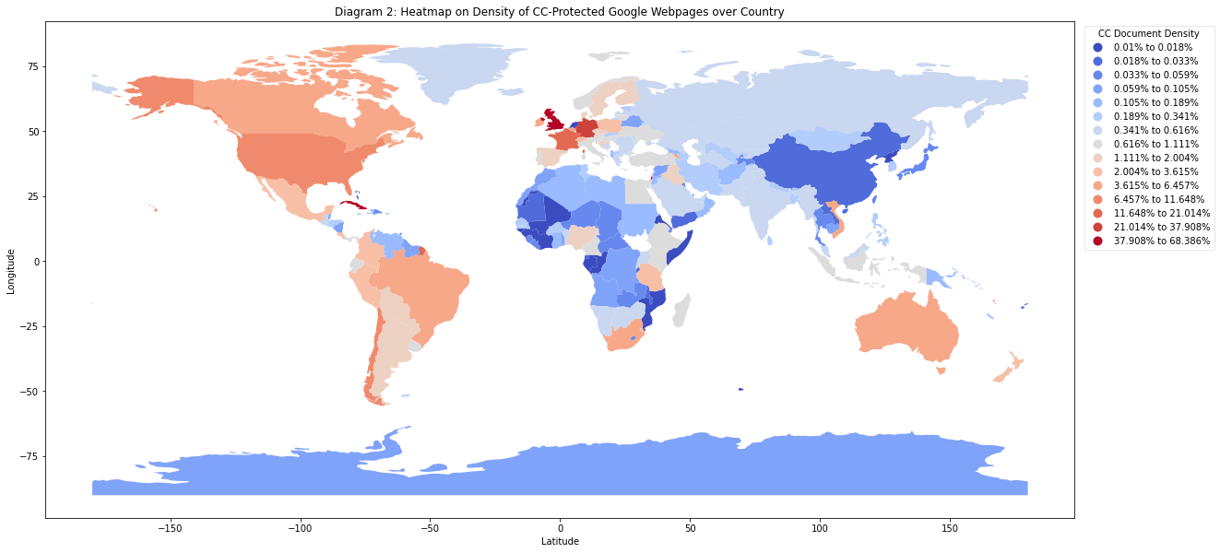

Slide 21
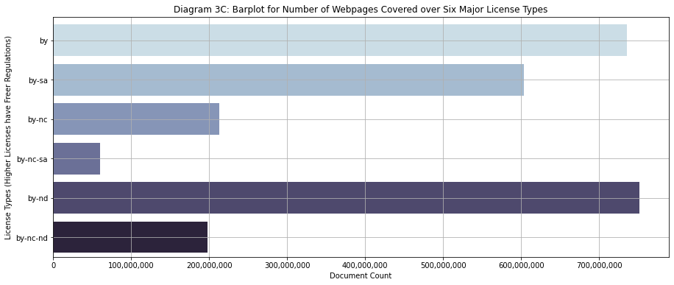
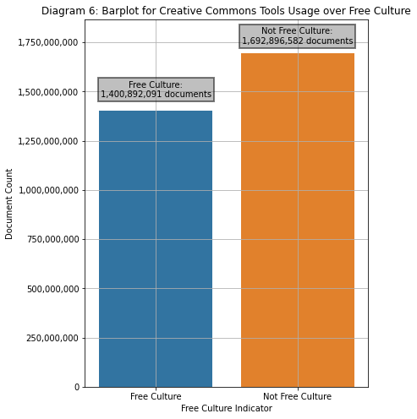
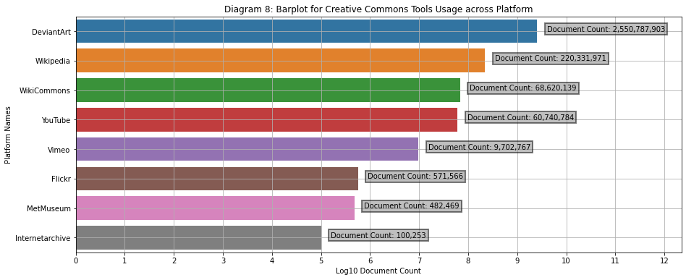

Slide 22
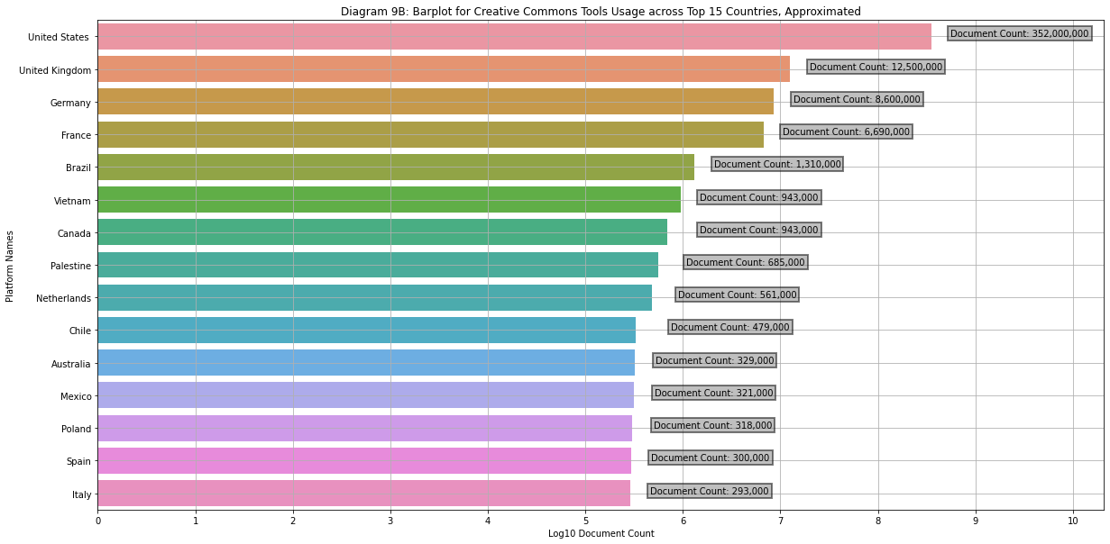
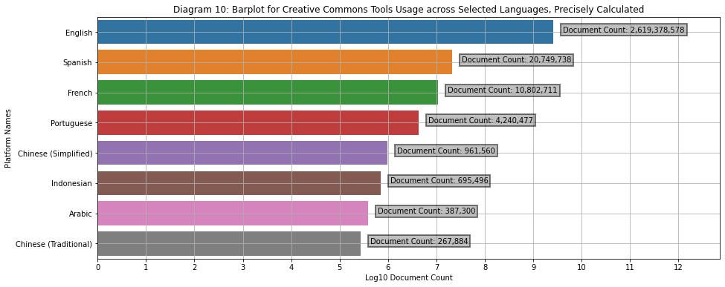
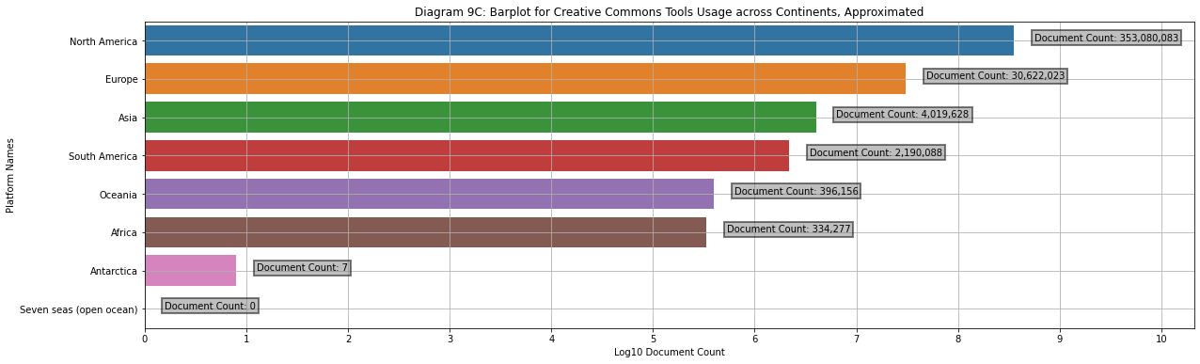

Slide 23
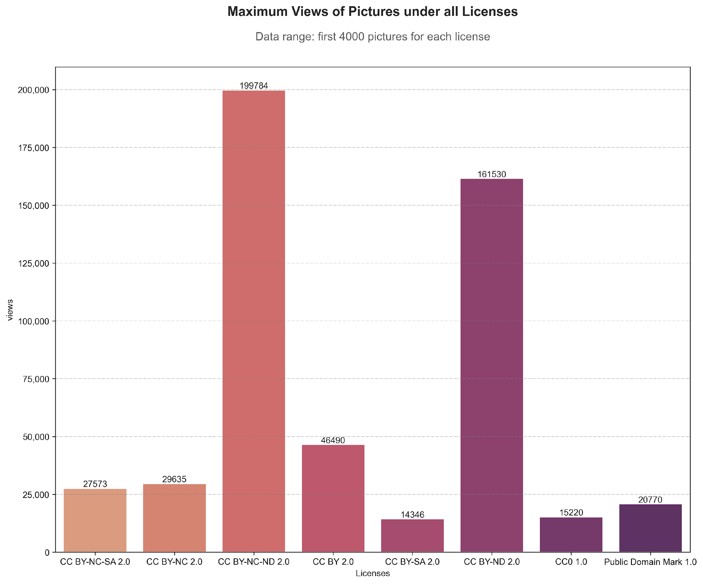
Visualization: Platform-wise Analysis, Flickr

Slide 24
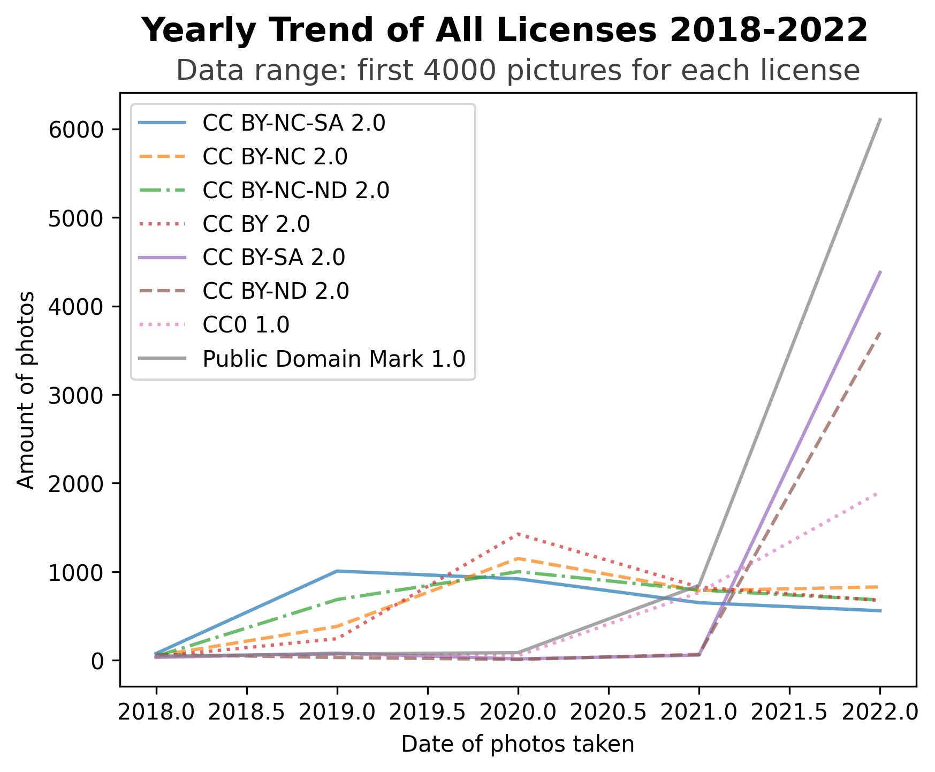
Visualization: Platform-wise Analysis, Flickr

Slide 25
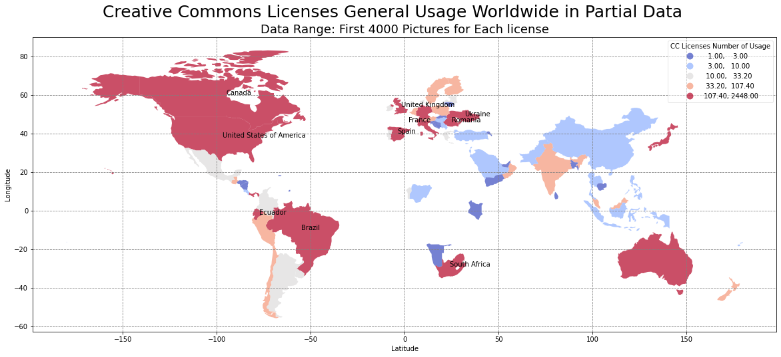
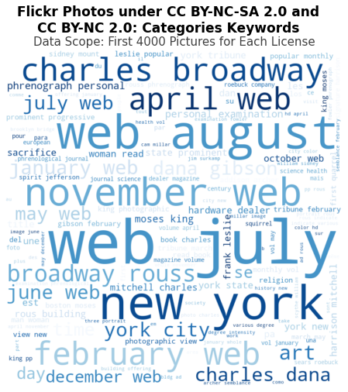
Visualization: Platform-wise Analysis, Flickr

Slide 26
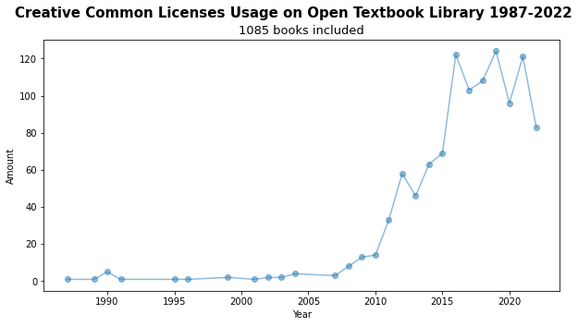
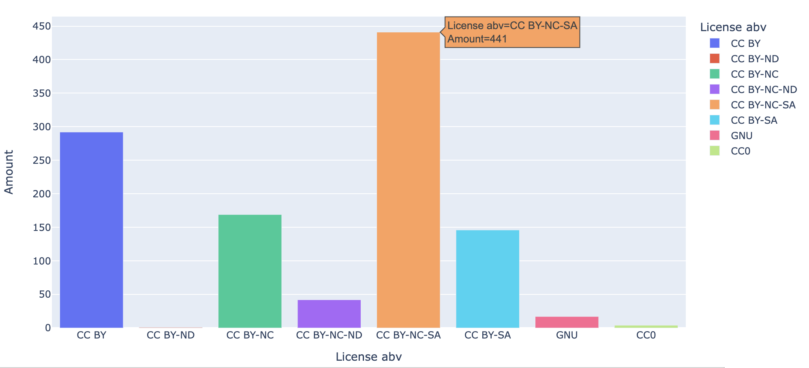
Visualization: Platform-wise Analysis, O.E.R.s

Slide 27
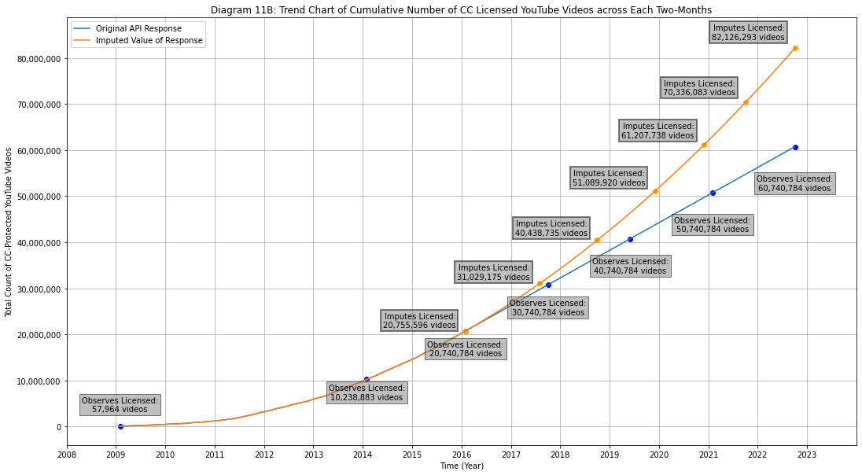

Slide 28
Project Objectives
Quantify the Size and Diversity of Commons
Retrieval
Visualize
Modeling

Slide 29
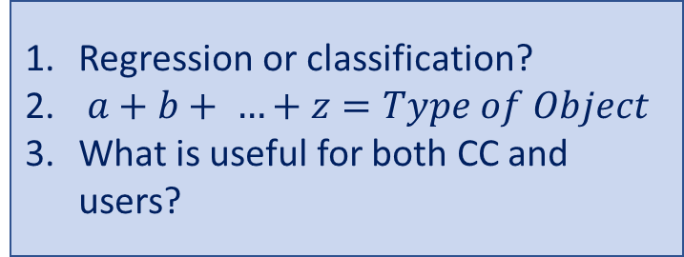
Modeling: Deciding a Question
Ask Question
Obtain Data
Questions
Answer Question
Understand Data
For this model, given a webpage’s content, classify it among the licenses:
by, by-sa, by-nc, by-nc-nd, by-nc-sa, by-nd, publicdomain
Use top k accuracy as main metric, as this is a recommendation system.
Modeling
Deliverable

Slide 30
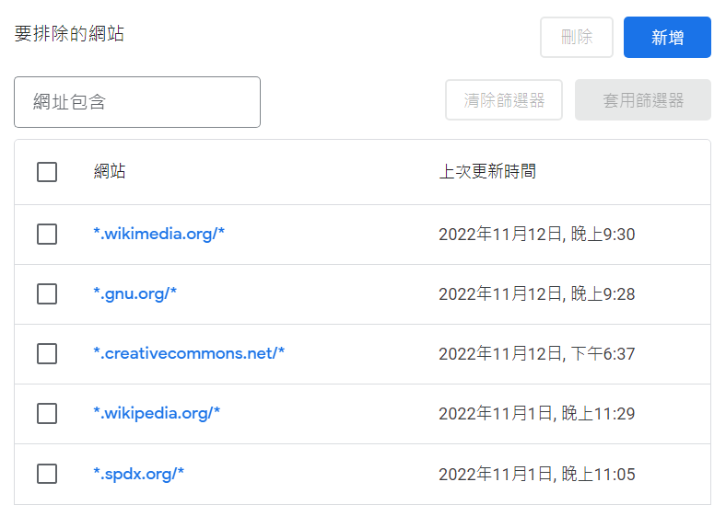
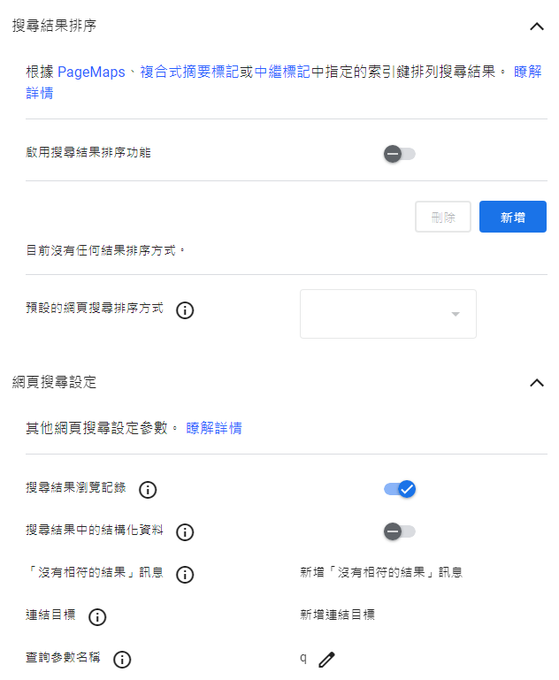

Modeling: Acquiring Dataset
Ask Question
Obtain Data
Answer Question
Understand Data
Modeling
Deliverable

Slide 31
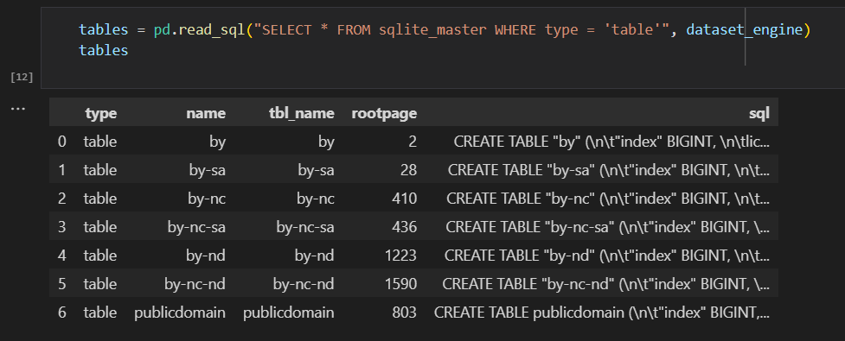
Modeling: Acquiring Dataset
Ask Question
Obtain Data
Answer Question
Understand Data
Modeling
Deliverable

Slide 32
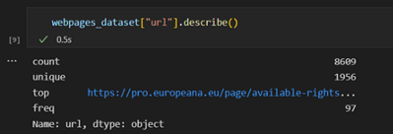
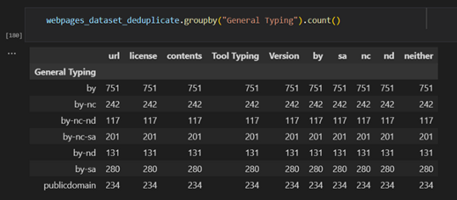
Modeling: EDA
Webpage Content
Preprocessing
Model Selection and Training
Classification Model Complete

Slide 33
Modeling: Text Preprocessing
Deduplication

Slide 34
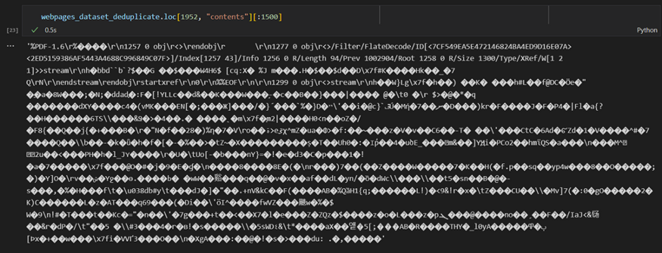
Modeling: Text Preprocessing
Deduplication
Non-English Characters

Slide 35
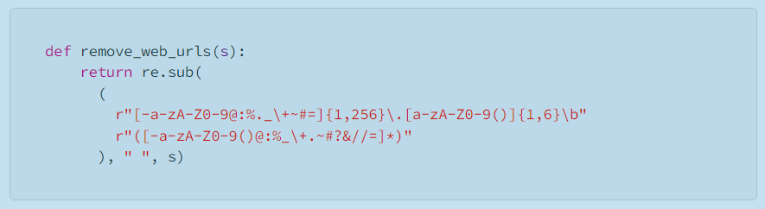
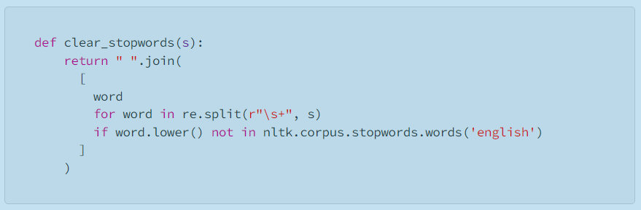
Modeling: Text Preprocessing
Deduplication
Non-English Characters
URL, [^\w\s], Stopword Removal

Slide 36
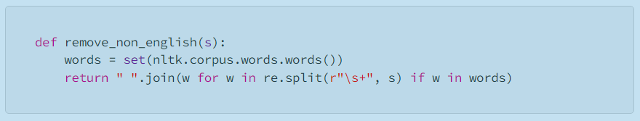
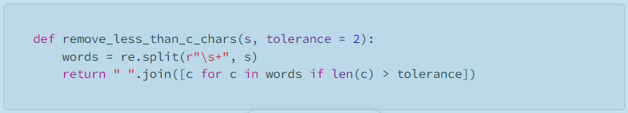
Modeling: Text Preprocessing
Deduplication
Non-English Characters
URL, [^\w\s], Stopword Removal
Remove non-English, short words, short contents

Slide 37
Modeling: Preprocessing, Word Embedding
Ask Question
Obtain Data
TF-IDF
Word2Vec
Answer Question
Understand Data
BERT
Modeling
Deliverable

Slide 38
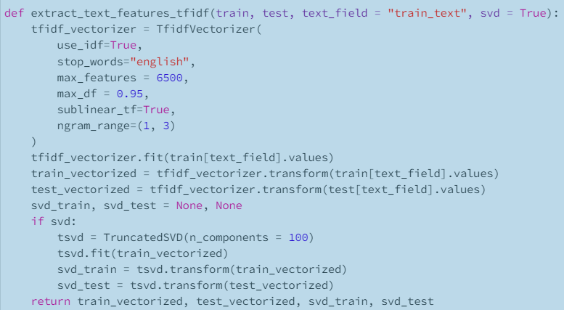
Modeling: Training
TFIDF + SVD
Ask Question
Obtain Data
Answer Question
Understand Data
Modeling
Deliverable

Slide 39
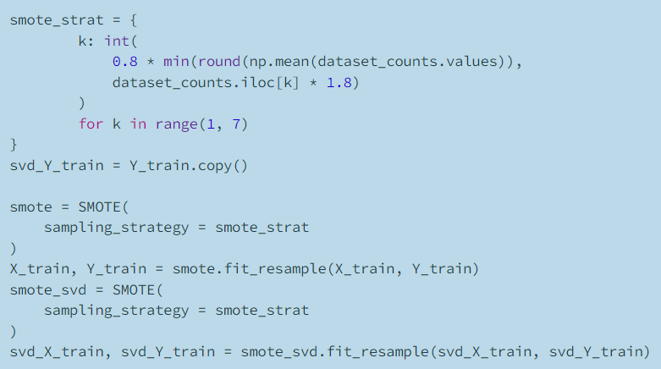
Modeling: Training
TFIDF + SVD
Ask Question
Obtain Data
SMOTE
Answer Question
Understand Data
Modeling
Deliverable

Slide 40
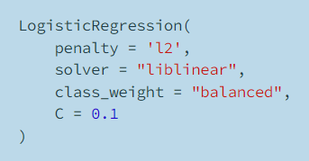
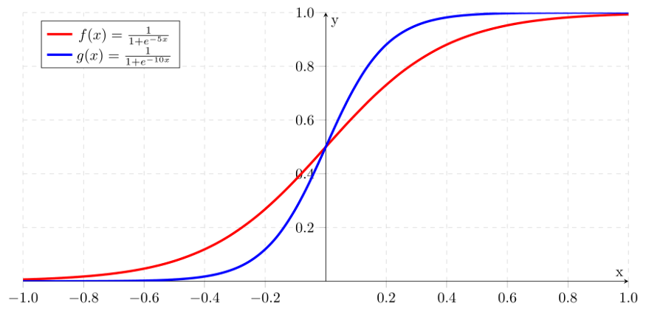
Modeling: Selections
Ask Question
Obtain Data
Answer Question
Understand Data
Modeling
Deliverable

Slide 41
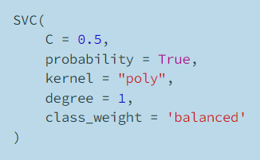
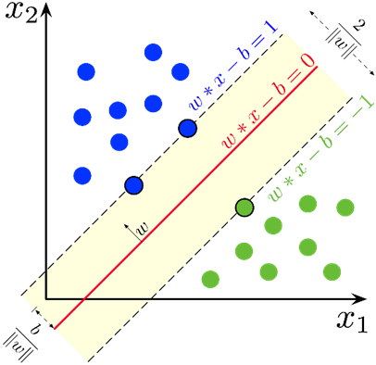
Modeling: Selections
Ask Question
Obtain Data
Answer Question
Understand Data
Modeling
Deliverable

Slide 42
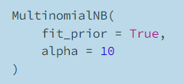
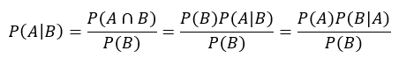
Modeling: Selections
Ask Question
Obtain Data
Answer Question
Understand Data
Modeling
Deliverable

Slide 43
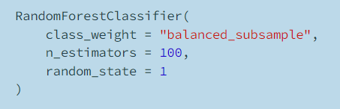
Modeling: Selections
Ask Question
Obtain Data
Decision Tree
Decision Tree
Answer Question
Understand Data
Decision Tree
Decision Tree
Modeling
Vote
Deliverable
Random Forest

Slide 44
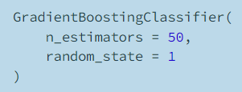
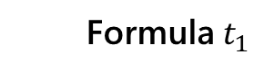
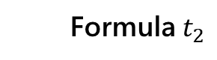

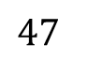



Modeling: Selections
Ask Question
Obtain Data
Answer Question
Understand Data
Gradient Descent
New Parameter
Modeling
Gradient Descent
New Parameter
Deliverable

Slide 45


Modeling: Selections
Ask Question
Obtain Data
Answer Question
Understand Data
Modeling
Deliverable

Slide 46

Modeling: Flickr, NLP + SVM
Cleaning data
Translating non-English words
Word Tokenization & Stemming
Stopwords Checking
word vectorization

Slide 47

Modeling: Flickr, NLP + SVM
unstoppable | 4573 | charles | 735
broadway | 564 | sharpen | 3966
farm | 1593 | phrenograph | 3166
An example of the words in the description of the photos and how the vectorization looks like

Slide 48

Modeling: Training Results

Slide 49

Modeling: Training Results

Slide 50

Modeling: Flickr, NLP + SVM
Random Shuffling
Train Test Splitting
Support Vector Machines Performing
Accuracy Calculation
Visualization
The accuracy score mostly concentrate on 69 to 70, highest score is about 76

Slide 51
Project Deliverables
Retrieval
Visualize
Modeling

Slide 52


Project Deliverables: Retrieval
Unstable
Reliable

Slide 53

Project Deliverables: Retrieval
Unstable
Reliable
Unavailable
Interpretable

Slide 54

Project Deliverables: Retrieval
Unstable
Reliable
Unavailable
Interpretable
Unexplored
Documented

Slide 55
Project Deliverables: Visualization
Presented
Exhibitory

Slide 56

Project Deliverables: Visualization
Presented
Exhibitory
Already Attainable
Effortfully Extractable

Slide 57




Project Deliverables : Visualization
Presented
Exhibitory
Already Attainable
Effortfully Extractable
Surface
Breadth and Depth

Slide 58
Project Deliverables
Practiced

Slide 59
Project Deliverables
Practiced
Implications

Slide 60
Quantifying the Commons
Common
Communication
Course of Change
Quantify for Quality

